Slide 1



01CE0723 - DATA WAREHOUSING & DATA MINING
Unit - 2
Data Mining
Dr. Ruchi Patel
Associate Professor
Computer Engineering Department

Slide 2


Outline
Motivation and importance of data mining
Different kinds of data
Data mining functionalities
Classification of data mining systems
Data mining task primitives
Integration of a data mining system with a Database or a Data Warehouse
KDD Process
Major issues in Data Mining

Slide 3
Motivation and importance of data mining
The Explosive Growth of Data: from terabytes to petabytes
Data collection and data availability
Automated data collection tools, database systems, Web, computerized society
Major sources of abundant data
Business: Web, e-commerce, transactions, stocks, …
Science: Remote sensing, bioinformatics, scientific simulation, …
Society and everyone: news, digital cameras, YouTube
We are drowning in data, but starving for knowledge!
“Necessity is the mother of invention”—Data mining—Automated analysis of massive data sets

Slide 4
What Is Data Mining?
Data mining (knowledge discovery from data)
Extraction of interesting patterns or knowledge from huge amount of data.
Alternative names
Knowledge discovery (mining) in databases (KDD), knowledge extraction, data/pattern analysis, data archeology, information harvesting, business intelligence, etc.

Slide 5
What kind of data can be Mined..?
Flat files
Relational database
Data warehouse
Transactional database
Multimedia database
Spatial database
Time-series database
World wide web

Slide 6
Data Mining Functionalities
What kinds of patterns can be mined?
Concept/Class Description: Characterization and Discrimination
-> Data can be associated with classes or concepts.
E.g. classes of items – computers, printers, …
concepts of customers – bigSpenders, budgetSpenders, …
-> How to describe these items or concepts?
Descriptions can be derived via
1. Data characterization – summarizing the general characteristics of a target class of data.
E.g. summarizing the characteristics of customers who spend more than $1,000 a year at AllElectronics. Result can be a general profile of the customers, such as 40 – 50 years old, employed, have excellent credit ratings.

Slide 7
Data Mining Functionalities
Descriptions can be derived via
2. Data discrimination – comparing the target class with one or a set of comparative classes
E.g. Compare the general features of software products whole sales increase by 10% in the last year with those whose sales decrease by 30% during the same period
3. Or both of the above
Mining Frequent Patterns, Associations and Correlations
-> Frequent itemset: a set of items that frequently appear together in a transactional data set (e.g. milk and bread)
-> Frequent subsequence: a pattern that customers tend to purchase product A, followed by a purchase of product B

Slide 8
Data Mining Functionalities
Association Analysis: find frequent patterns
-> E.g. a sample analysis result – an association rule:
buys(X, “computer”) => buys(X, “software”) [support = 1%, confidence = 50%]
(if a customer X buys a computer, there is a 50% chance that X will buy software. 1% of all of the transactions under analysis showed that computer and software are purchased together.)
-> Associations rules are discarded as uninteresting if they do not satisfy both a minimum support threshold and a minimum confidence threshold.
Correlation Analysis: additional analysis to find statistical correlations between associated pairs

Slide 9
Data Mining Functionalities
Classification and Prediction
-> Classification
* The process of finding a model that describes and distinguishes the data classes or concepts, for the purpose of being able to use the model to predict the class of objects whose class label is unknown.
* The derived model is based on the analysis of a set of training data (data objects whose class label is known).
* The model can be represented in classification (IF-THEN) rules, decision trees, neural networks, etc.
-> Prediction
* Predict missing or unavailable numerical data values

Slide 10
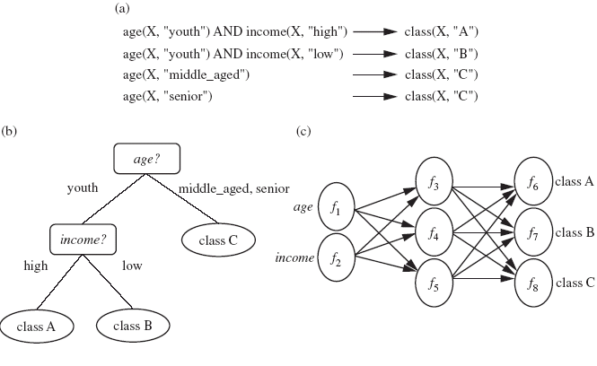
Data Mining Functionalities

Slide 11
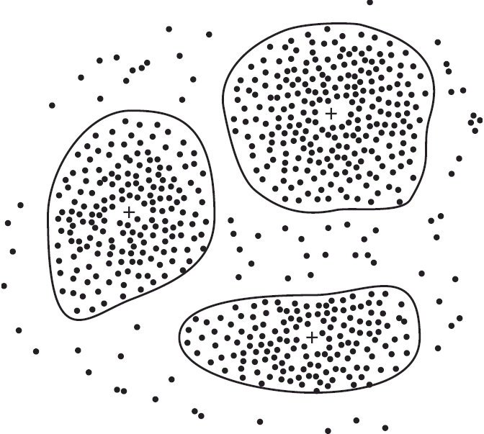
Data Mining Functionalities
Cluster Analysis
-> Class label is unknown: group data to form new classes
-> Clusters of objects are formed based on the principle of maximizing intra-class similarity & minimizing interclass similarity
E.g. Patients – Diseases

Slide 12
Data Mining Functionalities (cont.)
Outlier Analysis
-> Data that do no comply with the general behaviour or model.
-> Outliers are usually discarded as noise or exceptions.
-> Useful for fraud detection.
E.g Spam mails, more calls to irregular-unknown numbers(telemarketing)
Evolution Analysis
-> Describes and models regularities or trends for objects whose behaviour changes over time.
E.g. Identify stock evolution regularities for overall stocks and for the stocks of particular companies.

Slide 13
Classification of data mining systems
Database
Technology
Statistics
Machine
Learning
Data Mining
Visualization
Pattern
Recognition
Other
Disciplines
Algorithm

Slide 14
Classification of data mining systems
Database
Relational, data warehouse, transactional, stream, object-oriented/relational, spatial, time-series, text, multi-media, heterogeneous, WWW, etc.
Knowledge
Characterization, discrimination, association, classification, clustering, trend/deviation, outlier analysis, etc.
Multiple/integrated functions and mining at multiple levels
Techniques utilized
Database-oriented, data warehouse (OLAP), machine learning, statistics, visualization, etc.
Applications adapted
Retail, telecommunication, banking, fraud analysis, bio-data mining, stock market analysis, text mining, Web mining, etc.

Slide 15
Data Mining Task Primitives
How to construct a data mining query?
The primitives (structure/parts) allow the user to interactively communicate with the data mining
system during discovery to direct the mining process, or examine the findings.
The primitives:
(1) The set of task-relevant data – which portion of the database to be used
Database or data warehouse name
Database tables or data warehouse cubes
Condition for data selection
Relevant attributes or dimensions
Data grouping criteria

Slide 16
Data Mining Task Primitives (cont.)
The primitives:
(2) The kind of knowledge to be mined – what DB functions to be performed
Characterization
Discrimination
Association
Classification/prediction
Clustering
Outlier analysis
Other data mining tasks

Slide 17
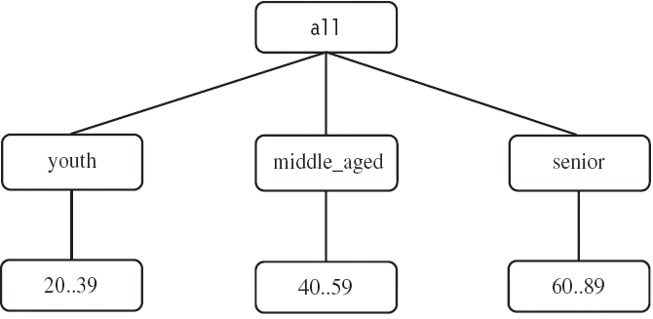
Data Mining Task Primitives (cont.)
The primitives:
(3) The background knowledge to be used – what domain knowledge, concept hierarchies, etc.
(4) Interestingness measures and thresholds – support, confidence, etc.
(5) Visualization methods – what form to display the result, e.g. rules, tables, charts, graphs, …

Slide 18
Integration of a data mining system with a Database
or a Data Warehouse
What is data integration :
Data integration is the process of combining data from multiple sources into a
cohesive and consistent view.
This process involves identifying and accessing the different data sources, mapping the data to a common format, and reconciling any inconsistencies or discrepancies between the sources.
The goal of data integration is to make it easier to access and analyze data that is
spread across multiple systems or platforms, in order to gain a more complete and
accurate understanding of the data.

Slide 19
Integration of a data mining system with a Database
or a Data Warehouse
Data integration can be challenging due to the variety of data formats, structures, and semantics used by different data sources.
Different data sources may use different data types, naming conventions, and schemas, making it difficult to combine the data into a single view.
There are mainly 2 major approaches for data integration
No Coupling
Loose Coupling
Semi-tight Coupling
Tight Coupling

Slide 20
Integration of a data mining system with a Database
or a Data Warehouse
No coupling
Flat file processing, no utilization of any functions of a DB/DW system
Not recommended
Loose coupling
Fetching data from DB/DW
Does not explore data structures and query optimization methods provided by DB/DW
system
Difficult to achieve high scalability and good performance with large data sets

Slide 21
Integration of a data mining system with a Database
or a Data Warehouse
Semi-tight
Efficient implementations of a few essential data mining primitives in a DB/DW system are provided, e.g., sorting, indexing, aggregation, histogram analysis, multiway join, precomputation of some functions
Enhanced DM performance
Tight
DM is smoothly integrated into a DB/DW system, mining query is optimized based on
mining query analysis, data structures, indexing, query processing methods of a DB/DW
system.
A uniform information processing environment, highly desirable

Slide 22
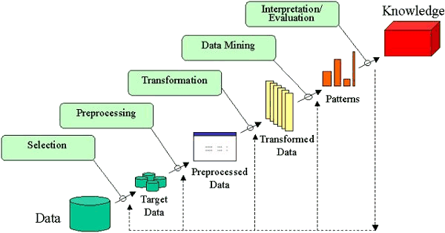
KDD Process

Slide 23
KDD Process
1. Data cleaning: To remove noise and inconsistent data
2. Data integration: Where multiple data sources may be combined
3. Data selection: Where data relevant to the analysis task are retrieved from the database
4. Data transformation: Where data are transformed or consolidated into forms appropriate for
mining by performing summary or aggregation operations, for instance
5. Data mining: An essential process where intelligent methods are applied in order to extract data patterns
6. Pattern evaluation: To identify the truly interesting patterns representing knowledge based on some interestingness measures
7. Knowledge presentation: Where visualization and knowledge representation techniques are
used to present the mined knowledge to the user

Slide 24
Major Issue in Data Mining
Mining methodology and User interaction
Mining different kinds of knowledge
DM should cover a wide spectrum of data analysis and knowledge discovery tasks
Enable to use the database in different ways
Require the development of numerous data mining techniques
Interactive mining of knowledge at multiple levels of abstraction
Difficult to know exactly what will be discovered
Allow users to focus the search, refine data mining requests
Incorporation of background knowledge
Guide the discovery process
Allow discovered patterns to be expressed in concise terms and different levels of abstraction

Slide 25
Major Issue in Data Mining
Data mining query languages and ad hoc data mining
High-level query languages need to be developed
Should be integrated with a DB/DW query language
Presentation and visualization of results
Knowledge should be easily understood and directly usable
High level languages, visual representations or other expressive forms
Require the DM system to adopt the above techniques
Handling noisy or incomplete data
Require data cleaning methods and data analysis methods that can handle noise
Pattern evaluation – the interestingness problem
How to develop techniques to access the interestingness of discovered patterns, especially with subjective measures bases on user beliefs or expectations

Slide 26
Major Issue in Data Mining
Performance Issues
Efficiency and scalability
Running time must be predictable and acceptable
Huge amount of data
Parallel, distributed and incremental mining algorithms
Divide the data into partitions and processed in parallel
Incorporate database updates without having to mine the entire data again from
scratch
Diversity of Database Types
Other database that contain complex data objects, multimedia data,
spatial data, etc.
Expect to have different DM systems for different kinds of data
Heterogeneous databases and global information systems
Web mining becomes a very challenging and fast-evolving field in data mining

Slide 27

Thank You

